Slide 1

Website Toko Baju
By : Kelompok 5

Slide 2
1
Rancangan – Rancangan
3
4
Tampilan Web
Tampilan Web Responsive
2
Source Code Tampilan

Slide 3
1. Rancangan – rancangan

Slide 4
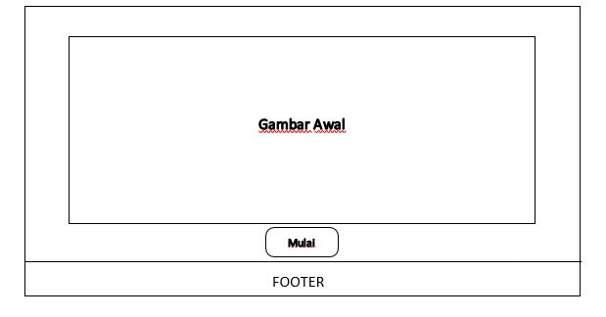
Rancangan Tampilan Awal

Slide 5
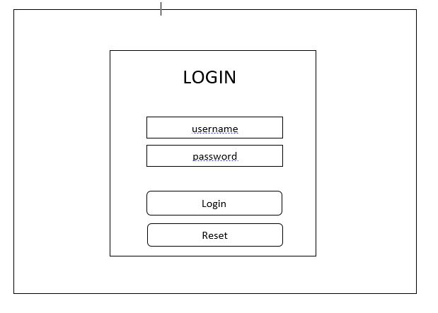
Rancangan Tampilan Login

Slide 6
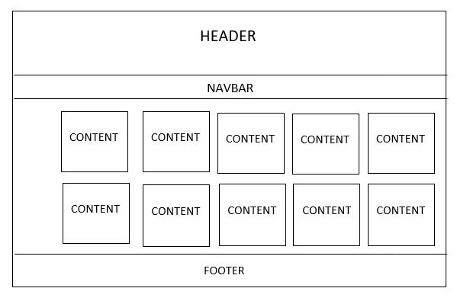
Rancangan Tampilan Home

Slide 7
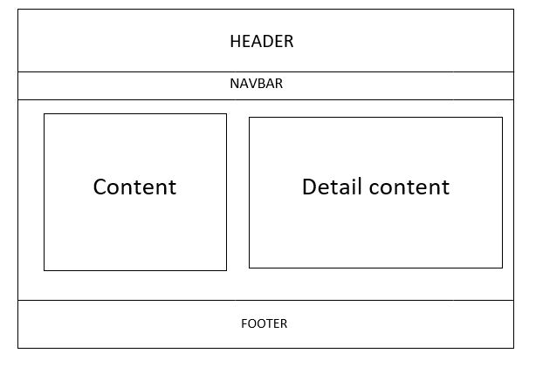
Rancangan Tampilan Detail Produk

Slide 8
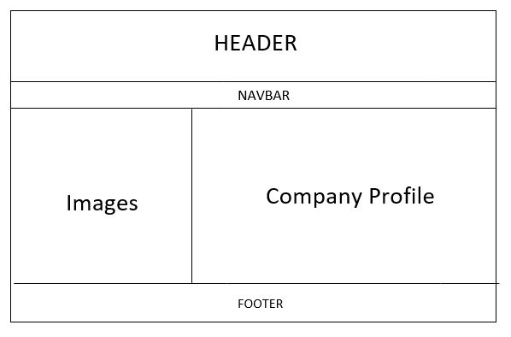
Rancangan Tampilan About Us

Slide 9
2. Source Code Tampilan

Slide 10
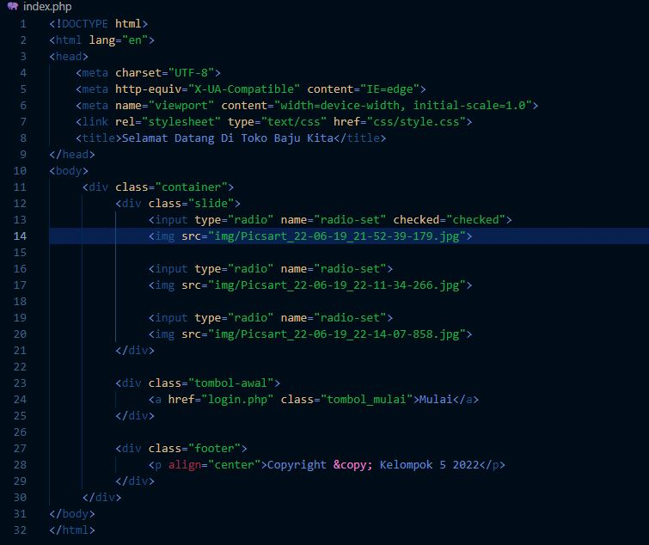
Source Tampilan Awal

Slide 11
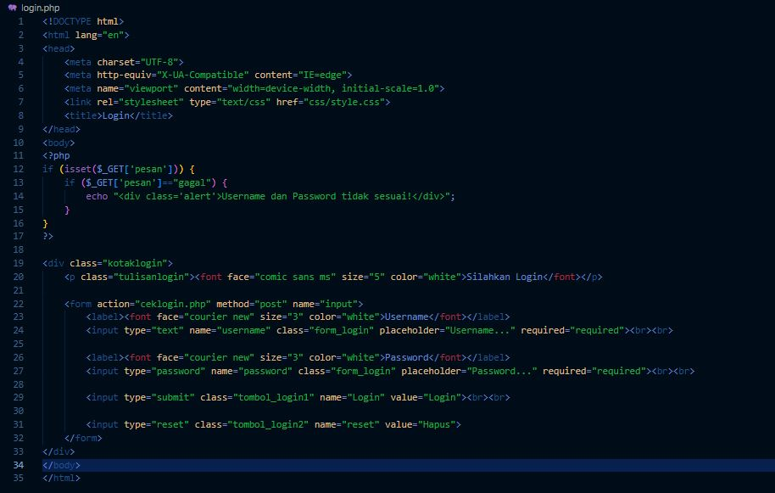
Source Tampilan Login

Slide 12
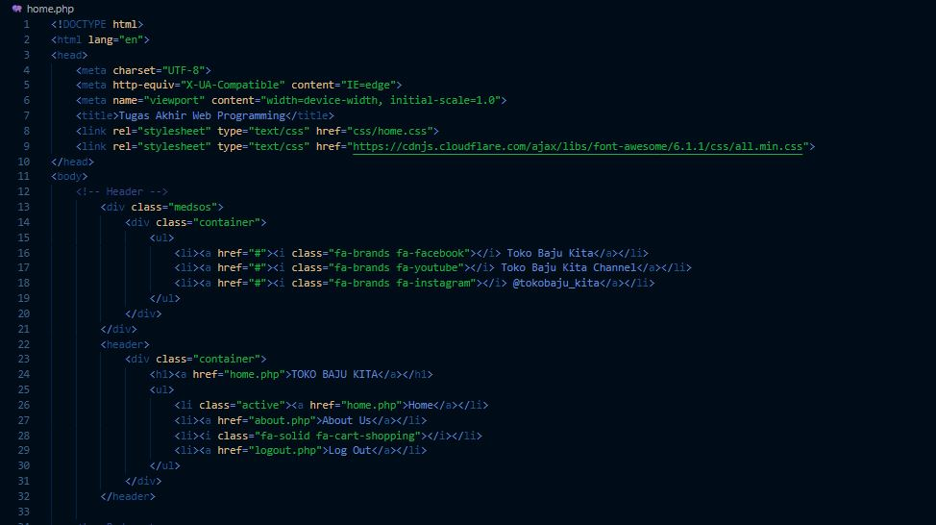
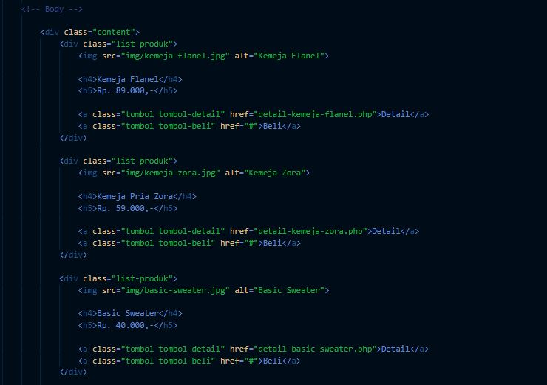
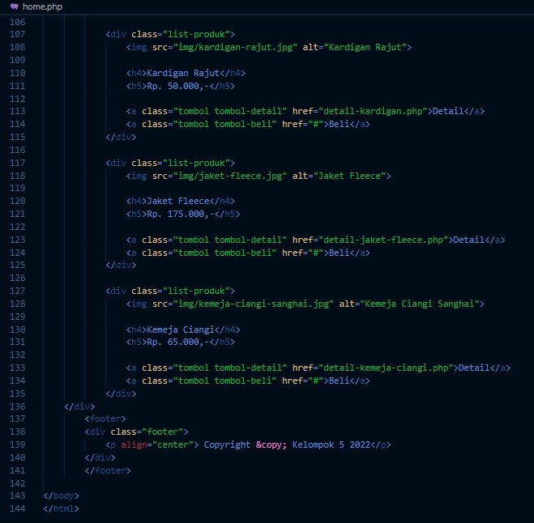
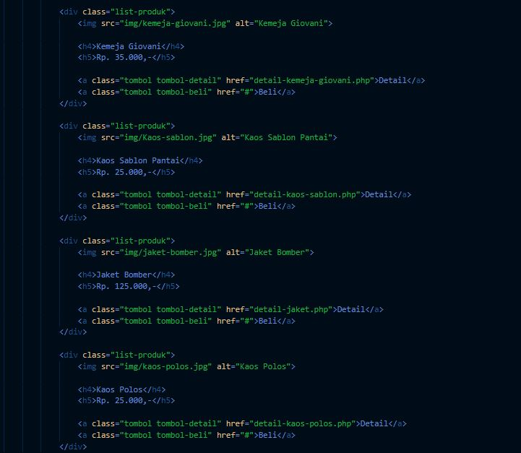
Source Tampilan Home

Slide 13
Contoh Source Tampilan Detail Produk

Slide 14
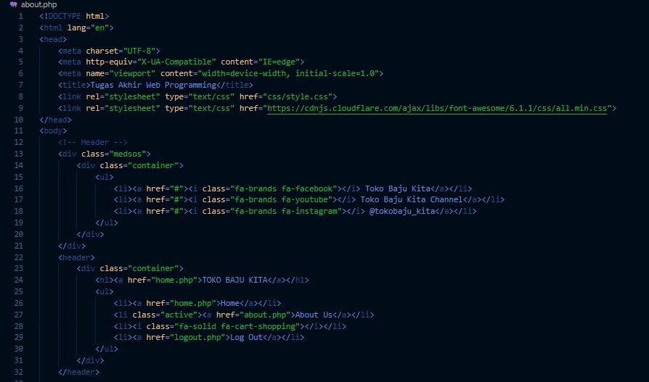
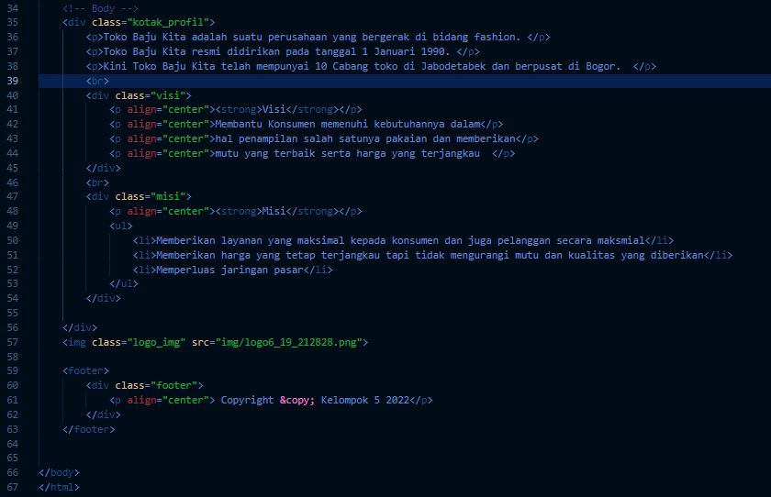
Source Tampilan About Us

Slide 15
3. Tampilan Web

Slide 16

Tampilan Awal

Slide 17
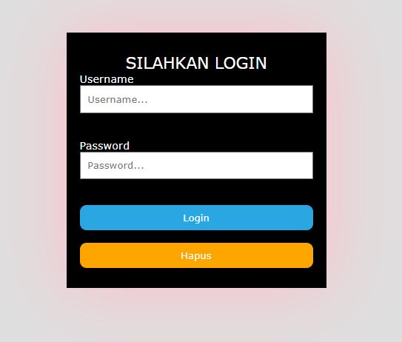
Tampilan Login

Slide 18
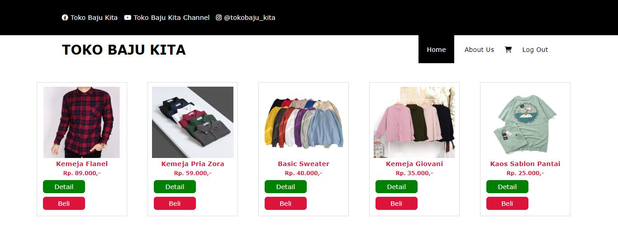
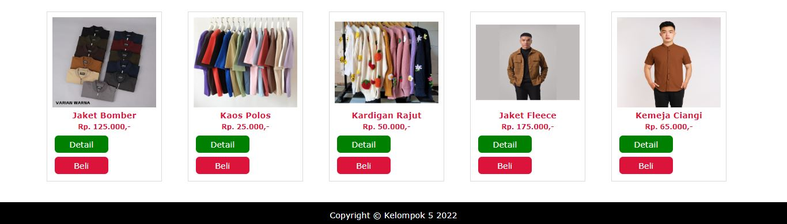
Tampilan Home

Slide 19
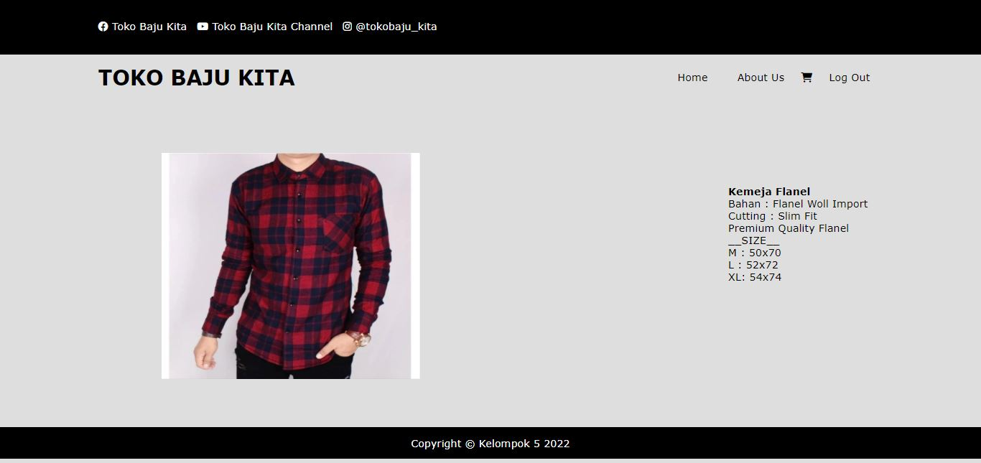
Tampilan Detail Produk

Slide 20
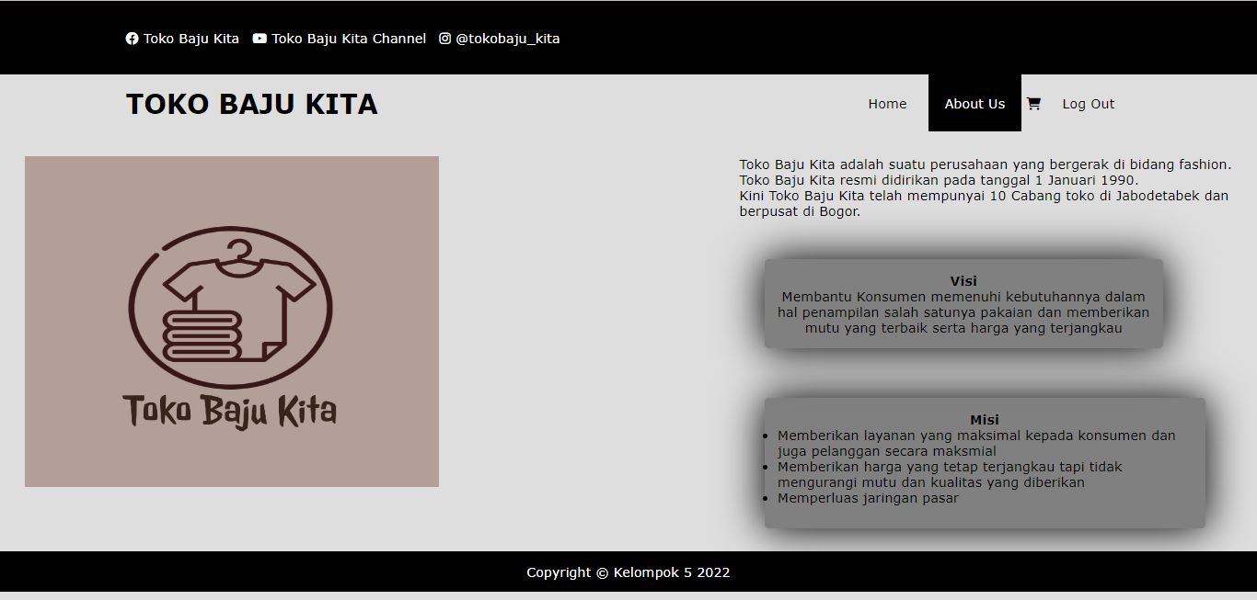
Tampilan About Us

Slide 21
Thank You ☺
By Kelompok 5 :
Akbar Husni Aziz (10210140)
Bintang Laura Anjani (10210016)
Kevin Arkadius (10210072)
Liling (10210110)
Muyassar Ihsan (10210102)

